Slide 1
OPERATING SYSTEMS
Protection

Slide 2
Goals
Operating system consists of a collection of objects (hardware or software).
Each object has a unique name and are accessible through some defined set of operations.
Set policies to ensure authorized access of objects within the computer system.

Slide 3
Principles of Protection
Principle of Least Privilege
Programs, users and systems should be given just enough privileges to perform their tasks.
A component's failure or compromise causes the least amount of damage.
Mechanism vs Policy
Mechanism is what is built into the OS for its protection.
Policy defines what states are allowed (i.e. authorized) or not allowed (i.e. unauthorized) for a given system.

Slide 4
Domain of Protection
Rings of protection separate functions into domains and order them hierarchically.
Computer can be treated as processes and objects.
Hardware objects (such as devices) and software objects (such as files, programs, semaphores.
Process for example should only have access to objects it currently requires to complete its task – the need-to-know principle.
Implementation can be via process operating in a protection domain.
Specifies resources process may access.
Each domain specifies set of objects and types of operations on them
Ability to execute an operation on an object is an access right.
<object-name, rights-set>
Domains may share access rights.
Associations can be static or dynamic.
If dynamic, processes can domain switch.

Slide 5
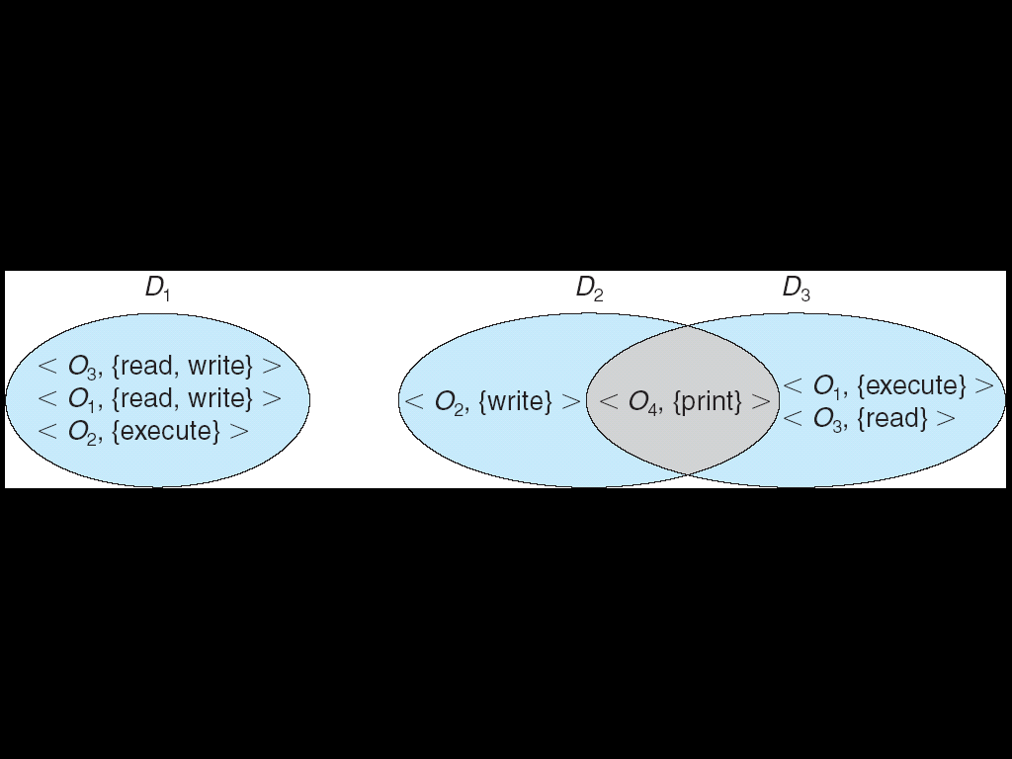
Domain Structure
Need-to-know-principle:
Processes should only be allowed to access resources which are necessary for completing tasks and for which they are authorized.
Domain => set of access-rights
Access-right = <object-name, rights-set> where rights-set is a subset of all valid operations that can be performed on the object.

Slide 6
Domain Implementation in UNIX
Domain = user-id
Domain switch accomplished via file system.
Each file has associated with it a domain bit (setuid bit).
When file is executed and setuid = on, then user-id is set to owner of the file being executed.
When execution completes user-id is reset.
Domain switch accomplished via passwords.
su command temporarily switches to another user’s domain when other domain’s password provided.
Domain switching via commands.
sudo command prefix executes specified command in another domain (if original domain has privilege or password given).

Slide 7
Domain Implementation in Android App IDs
In Android, distinct user IDs are provided on a per-application basis.
When an application is installed, the installd daemon assigns it a distinct user ID (UID) and group ID (GID), along with a private data directory (/data/data/<appname>) whose ownership is granted to this UID/GID combination alone.
Applications on the device enjoy the same level of protection provided by UNIX systems to separate users.
A quick and simple way to provide isolation, security, and privacy.
The mechanism is extended by modifying the kernel to allow certain operations (such as networking sockets) only to members of a particular GID (for example, AID INET, 3003).
A further enhancement by Android is to define certain UIDs as “isolated,” prevents them from initiating RPC requests to any but a bare minimum of services.

Slide 8
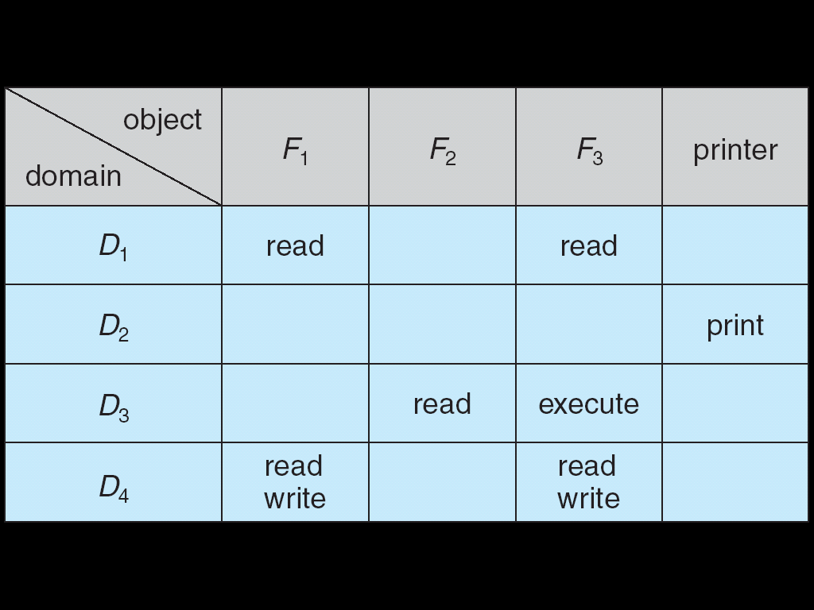
Access Matrix
View protection as a matrix (access matrix).
Columns => access-control list (ACL) for an object => represents objects.
Rows => capability list (permissible operations on objects, per domain) => represents domains.
Access(i, j) is the set of operations that a process executing in Domain_{i} can invoke on Object_{j}

Slide 9
Use of Access Matrix
If a process in Domain Dᵢ tries to do “op” on object Oⱼ, then “op” must be in the access matrix.
User who creates object can define access column for that object.
Can be expanded to dynamic protection.
Operations to add, delete access rights.
Special access rights:
owner of Oᵢ
copy “op” from Oᵢ to Oⱼ (denoted by “*”)
control – Dᵢ can modify Dⱼ access rights
transfer – switch from domain Dᵢ to Dⱼ
Copy and Owner applicable to an object.
Control applicable to domain object.
Access matrix design separates mechanism from policy.
Mechanism:
Operating system provides access-matrix + rules.
If ensures that the matrix is only manipulated by authorized agents and that rules are strictly enforced.
Policy:
User dictates policy.
Who can access what object and in what mode.
But doesn’t solve the general confinement problem.

Slide 10
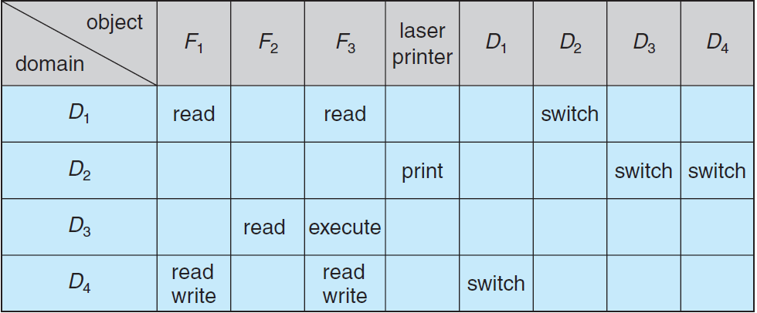
Access Matrix with Domains as Object
Switching Domains
Domain switch from D_{i} to D_{j} is possible only if access right switch ∈ access(i, j)

Slide 11
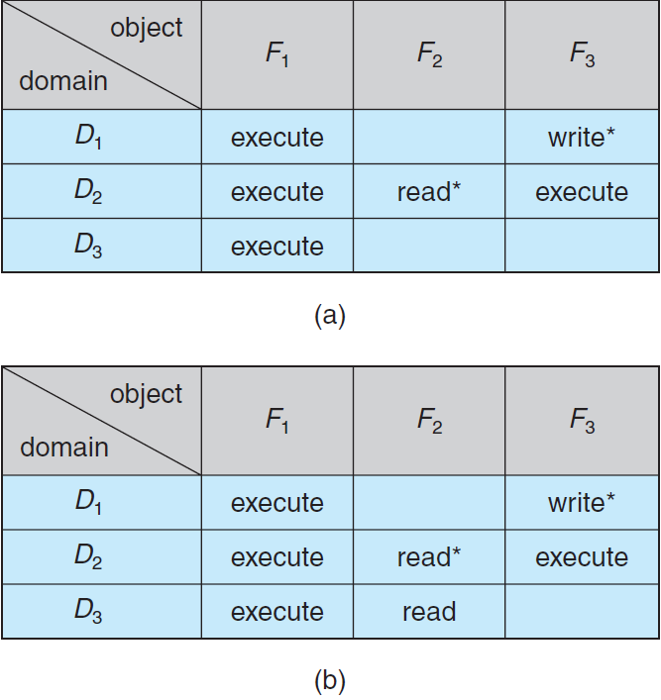
Access Matrix with Copyrights
Copyrights
Asterisk denotes that an access right can be copied within column.
Process executing in domain D2 copies the read operation into another entry associated with file F2

Slide 12
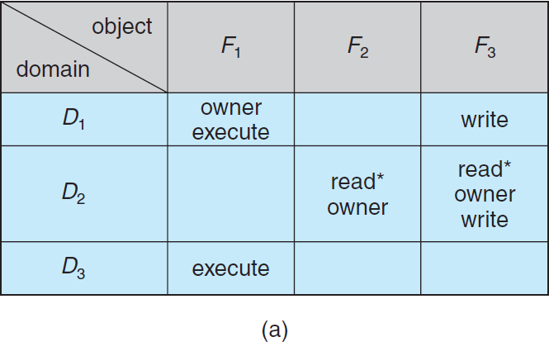
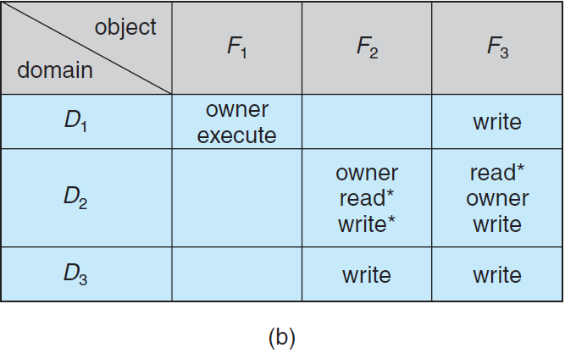
Access Matrix with Owner Rights
Owner Rights
Ownership: Can add or remove rights.

Slide 13
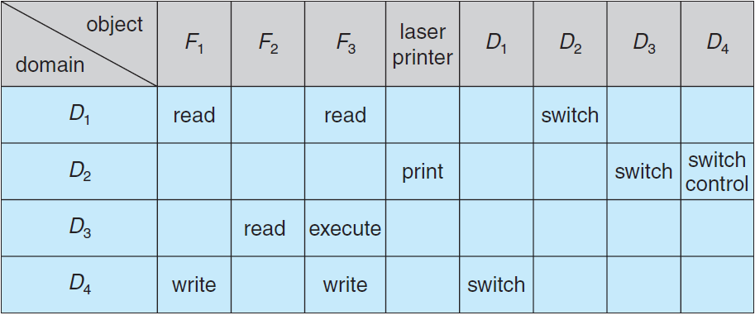
Access Matrix with Control Rights
Control Rights
Control: Process executing in one domain can modify another domain.
A process executing in domain D₂ could modify domain D₄

Slide 14
Access Matrix with Control Rights
Control Rights
Control: Process executing in one domain can modify another domain.
A process executing in domain D₂ could modify domain D₄

Slide 15
Revocation of Access Rights
Access-List Scheme
Search for right to be revoked, then delete.
Immediate or Delayed.
Selective or General.
Partial or Total.
Temporary or Permanent.
Capabilities
Identify capabilities before revoking them
Reacquisition Try to reacquire after deletion | Back-pointers: point from object to capabilities Expensive (used in MULTICS)
Indirection Capability points to entry in table Not selective | Keys One key per capability Check in global key table

Slide 16
Mandatory Access Control (MAC)
Operating systems traditionally had discretionary access control (DAC) to limit access to files and other objects (for example UNIX file permissions and Windows access control lists (ACLs)).
Discretionary is a weakness – users / admins need to do something to increase protection.
Stronger form is mandatory access control, which even root user can’t circumvent.
Makes resources inaccessible except to their intended owners.
Modern systems implement both MAC and DAC, with MAC usually a more secure, optional configuration (Trusted Solaris, TrustedBSD (used in macOS), SELinux), Windows Vista MAC).
At its heart, labels assigned to objects and subjects (including processes).
When a subject requests access to an object, policy checked to determine whether or not a given label-holding subject is allowed to perform the action on the object.

Slide 17
Capability-Based Systems
Hydra and CAP were first capability-based systems.
Now included in Linux, Android and others, based on POSIX.1e (that never became a standard).
Essentially slices up root powers into distinct areas, each represented by a bitmap bit.
Fine grain control over privileged operations can be achieved by setting or masking the bitmap.
Three sets of bitmaps – permitted, effective, and inheritable.
Can apply per process or per thread.
Once revoked, cannot be reacquired.
Process or thread starts with all privs, voluntarily decreases set during execution.
Essentially a direct implementation of the principle of least privilege.
An improvement over root having all privileges but inflexible (adding new privilege difficult, etc.).

Slide 18
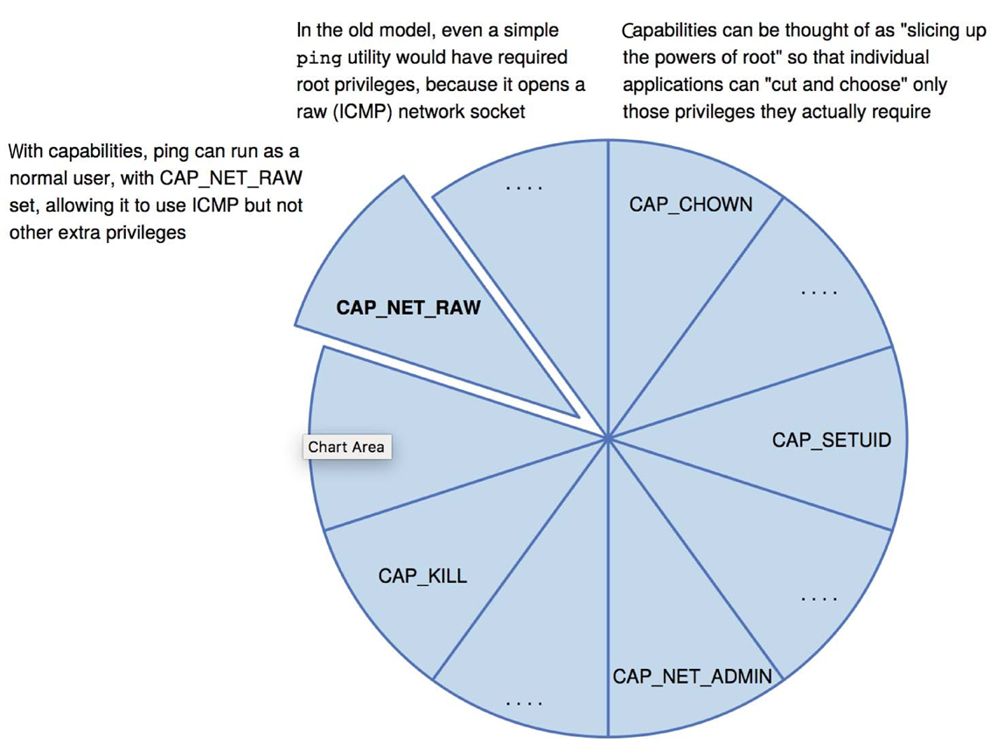
Capabilities in POSIX.1e

Slide 19
Other Protection Improvement Methods
System integrity protection (SIP):
Introduced by Apple in macOS 10.11.
Restricts access to system files and resources, even by root.
Uses extended file attributes to mark a binary to restrict changes, disable debugging and scrutinizing.
Also, only code-signed kernel extensions allowed and configurable only code-signed apps.
System-call filtering:
Like a firewall, for system calls.
Can also be deeper –inspecting all system call arguments.
Linux implements via SECCOMP-BPF (Berkeley packet filtering).
Sandboxing:
Running process in limited environment.
Impose set of irremovable restrictions early in startup of process (before main()).
Process then unable to access any resources beyond its allowed set.
Java and .net implement at a virtual machine level.
Other systems use MAC to implement.
Apple was an early adopter, from macOS 10.5’s “seatbelt” feature.
Dynamic profiles written in the Scheme language, managing system calls even at the argument level.
Apple now does SIP, a system-wide platform profile.

Slide 20
Language-Based Protection
Specification of protection in a programming language allows the high-level description of policies for the allocation and use of resources.
Language implementation can provide software for protection enforcement when automatic hardware-supported checking is unavailable.
Interpret protection specifications to generate calls on whatever protection system is provided by the hardware and the operating system.

